Slide 1
Arrays & Collections

Slide 2
Arrays | Collections
1. Size is fixed | 1. Size is not fixed, size is growable
2. Can hold both primitive types(boolean, byte, short, int, long …etc) and object types. | 2. Can hold only object types
3. There is no underlying data structures in arrays. The array itself used as data structure in java. | 3. Every Collection class there is underlying data structure.
4. There is no utility methods in arrays | 4. Every Collection provides utility methods

Slide 3
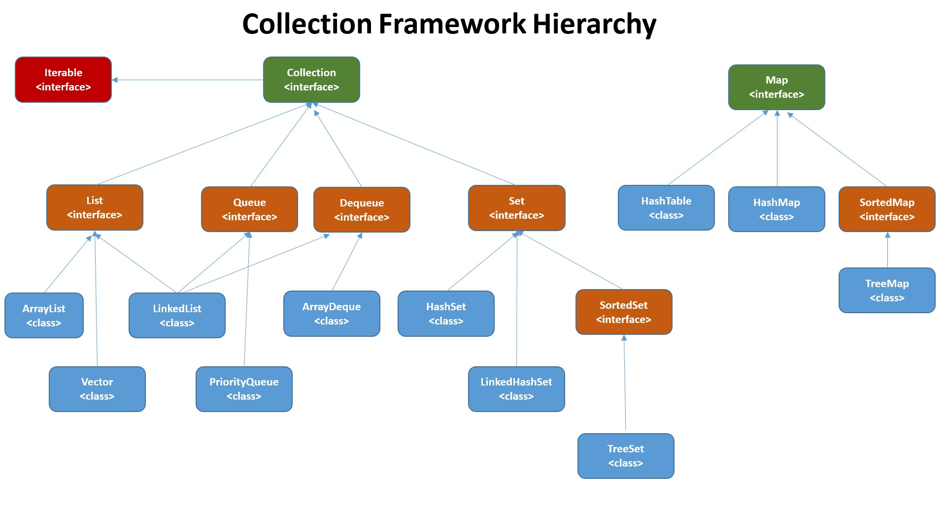

Slide 4
All the classes and interfaces of the collection framework are in java.util package. This hierarchy for the collection framework specifically mentioned the class and interface with respect to each type.
Iterable Interface
The Iterable interface is the root interface for all the collection classes because the Collection interface extends the Iterable interface, therefore, all the subclasses of Collection interface also implement the Iterable interface.
The iterable interface contains only one abstract method.
Iterator iterator(): It returns the iterator over the elements of type T.
Iterator Interface
The iterator interface provides the facility of iterating the elements in a forward direction only. For more detail: Java: Iterator Interface methods and Examples

Slide 5
The Collection interface extends Iterable and hence all child classes of Collection also implement Iterable.
Iterable has only one method that produces an Iterator:
public interface Iterable<T> {
public Iterator<T> iterator();
}
This Iterator can then be used to iterate over the elements in the Iterable

